Slide 1
SIT216 User Centred Design
Topic 2
Understanding How Users Think

Slide 2
Last topic...
Types of users
Describing a problem from the perspective of users.
User Personas

Slide 3
Classes of Users
People are only a novice for a short period of time
There are not three classes but a gradation and people will move backwards or forwards along the scale of expertise
People very quickly become experts in regularly used sections of an application.

Slide 4
Personas
Personas are used to develop a precise description of users and their requirements.
Personas combine characteristics of real people into one or more “imaginary” people.
Personas are useful in helping to guide decisions about a product, such as features, interactions, and visual design.

Slide 5
Advantages
Said to be cognitively compelling because they put a personal human face on otherwise abstract data about customers.
By thinking about the needs of a fictional persona, designers may be better able to infer what a real person might need.
Easy to communicate to developers and others to absorb customer data in a palatable format.

Slide 6
Criticisms
No clear way to determine how many users are represented by any given persona.
No definite relationship to real customer data and therefore cannot be scientific.
Needs to be validated through user testing.
Small projects have fewer resources.

Slide 7
Applying Personas to Design
A software product will be used by many types of user each of whom have different goals and needs.
Identification of the primary user is critical.
If there is more than one primary user then more than one interface will be required.

Slide 8
This Topic
Perception
Cognition
Mental Models

Slide 9
Interaction and perception
1

Slide 10
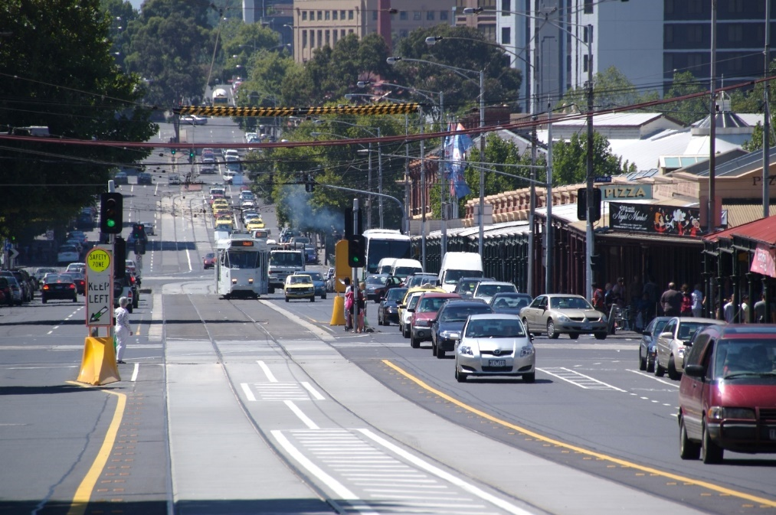
Human Interaction
Is a two-way street

Slide 11
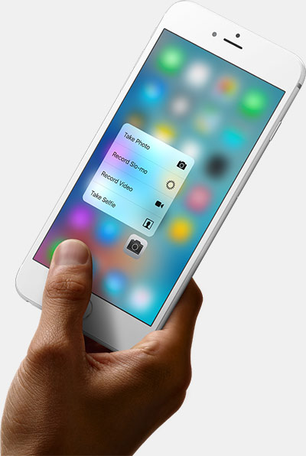
Human Interaction
One view is what interaction we have with the interface

Slide 12
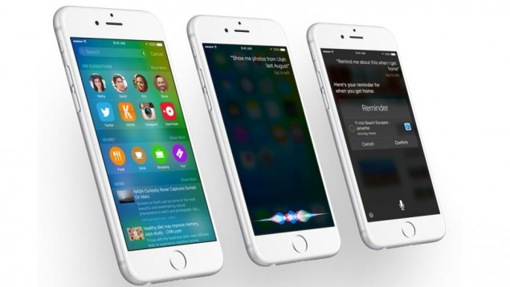
Human Interaction
The other view is how we perceive and interpret what happens on the screen

Slide 13
Activity - Perception
Our ability to perceive the digital world is dependant on the input and output of information
For each of the senses below, list an example of a hardware device or software (such as an app/website/digital system):
Vision ➔
Monitor/Screen, Virtual Worlds/Realities
Hearing ➔
Speakers (public or private)
Alerts, speech, mood, etc

Slide 14
Activity - Perception
Touch/Dexterity ➔
input devices
mouse, keyboard, touch screen, gaming controller
Vocalisation ➔
speech recognition
speech in vs. speech out
Smell ➔
???
however may alert user to a malfunction

Slide 15
Perception
We mostly use vision to perceive what is happening with the interface.
Vision is essentially a two-step process.
The eye must be able to detect objects: they must be large enough, with contrast, of visible colour, etc.
The brain must process the retinal signals: context now becomes important. We must interpret what we see.

Slide 16
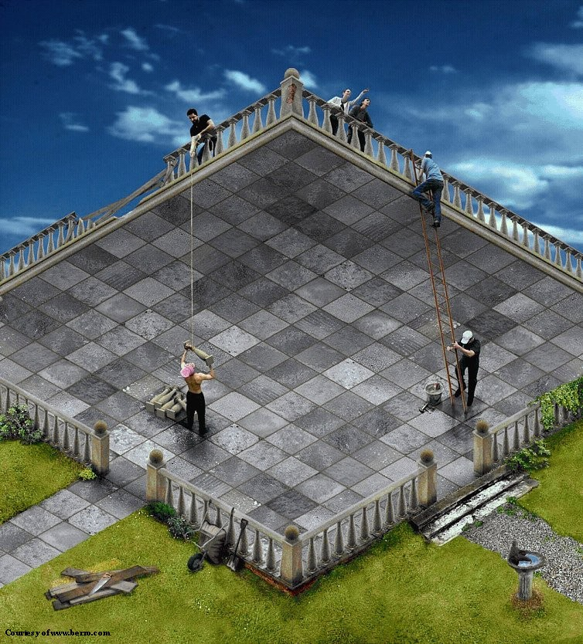
Activity - Perception
What can you see here?

Slide 17
MENTAL MODELS
2

Slide 18
Mental Models
Exercise: Calculate how many windows there are in a family member’s apartment.
You probably solved this problem in one of two ways:
You mentally walk through each room and “picture” turning around.
You mentally move around and count from outside.

Slide 19
Mental Models
Mental models enable people to:
generate descriptions and explanations about systems.
make predictions about future events.
find causes for unexplained events.
determine appropriate actions to cause desired changes.
remember relationships and events.

Slide 20
Types of Mental Models
Structural models describe how devices and systems work.
Functional models describe how to use a device or system.
Most people’s understanding of devices or systems is functional.

Slide 21
Some Observations
Mental models are incomplete
Each person holds their own representation of reality including superstitions and actions that “seem to work”.
People’s abilities to “run” their models is severely limited
because the models are incomplete.

Slide 22
Some Observations (cont.)
Mental models are unstable
unless we work with a model continuously it will degrade with time.
Mental models do not have firm boundaries
similar models can blend together and become confused.

Slide 23
Some Observations (cont.)
Mental models are “unscientific”
people maintain “superstitious” behaviour even when they know they are unneeded.
Mental models are parsimonious
people trade off extra physical action for reduced mental complexity.
… by Donald Norman

Slide 24
Conceptual Models
A conceptual model is devised as a tool for understanding a physical system.
Mental models are what people hold in their heads.
The conceptual model sits between the designer and the user to describe how each understands the system.
The conceptual model must be agreed to before the system can be designed and built.

Slide 25
Conceptual Models (cont.)
Conceptual
Model

Slide 26
Activity - Importance to UCD & Interface Design
Now considering the importance of conceptual models:
“As a designer, how will your target users interpret and interact with the information and communicate effectively using your system?”
Make some notes on how you should think about design and human limitations.

Slide 27
Activity - Importance to UCD & Interface Design
Your answer to the question, “As a designer, how will your target users interpret and interact with the information and communicate effectively using your system?” could have included points like:
Your design should be supportive of abilities and compensate for limitations.
Human memory is more effective if given appropriate cues.
Humans need time to retrieve information – this inevitably slows down response time.
Keep information within the user’s expectations. Also…

Slide 28
Activity - Importance to UCD & Interface Design
Repetition and familiarity allows for skills acquisition.
Consistency – the user will (and should) expect the same sequence of events for similar actions.
Provide visual and audio cues to confirm that user is progressing through tasks.

Slide 29
colour perception
3

Slide 30
Colour
Colour is best perceived where there are more cones (centre of the retina) and worst where there are more rods (periphery of the retina).
Colour is therefore better used in the centre of the screen rather than on the outside.
Most cones (96%) are red & green, so distinguishing shades of blue is lower than shades of red/green.

Slide 31
Activity - Colour
Therefore, blue text is harder to read than any other colour. Why are WWW links blue?
This writing is white on blue
This writing is blue on white

Slide 32
Activity - Colour
What do you see here?

Slide 33
Activity - Colour Use
When should colour be used?
Attracting attention
Grouping information
Indicating value
Aesthetic satisfaction

Slide 34

REPLACE Colour Use
Example:

Slide 35
Colour Perception
Chromostereopsis means that blue is perceived further away than red.
Never put red and blue next to each other
About 8% of males and 1% of females have red/green colour blindness.
Be careful with how you use red and green within an interface.

Slide 36
Colour Perception
This writing is red on blue
This writing is blue on red
This writing is red on green

Slide 37
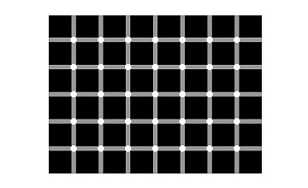
Perception
Count the black dots!

Slide 38
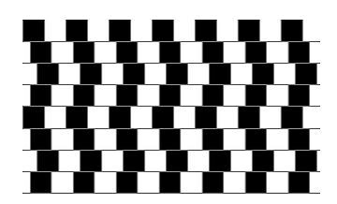
Perception
Are the horizontal lines parallel or do they slope?

Slide 39
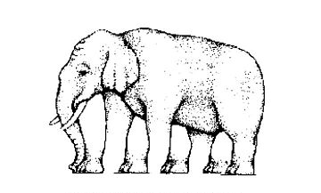
Perception
How many legs does this elephant have?

Slide 40
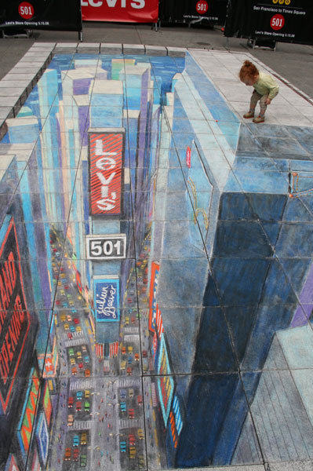
Perception
https://www.npr.org/sections/krulwich/2012/07/09/156495126/woman-on-street-attacked-by-giant-snail-it-seems

Slide 41
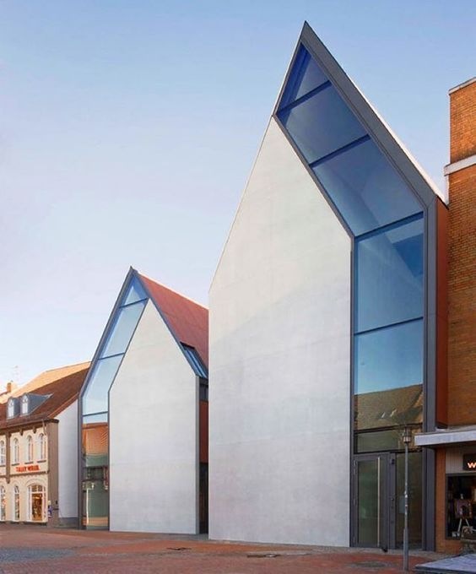
Perception
“These two facades of a northern Germany building for financial company Volksbank actually share very similar proportions, but diagonal placement gives off the illusion of one being bigger than the other.”
https://www.pinterest.com.au/pin/574420127468017751/

Slide 42
Activity - Perception
Are there any memorable visual illusions you would like to share with (and trick) the rest of the class?
Can you explain why we have problems perceiving exactly what is present/intended by the designers or architects?

Slide 43
Cognition
4

Slide 44
Cognition
The term we use to describe the way in which we interpret and understand information we receive from the outside world via the five senses
Enables perception and interpretation
This then leads to our action or implementation

Slide 45
Long-term Memory
Almost infinite.
Memory failure is inability to recall not learn.
Frequency of use enhances recall.
Two-stage process:
Recognition; cues activate the recall process
Recall

Slide 46
Short-term Memory
Characterised by temporary recall of information – the “notepad” or working memory
Conscious activity
Stores information that is only required for short periods (ie. NOT class material!!)
Readily accessed but only held temporarily

Slide 47
Short-term Memory
Most people can store up to seven ( -/+ 2) items of information
With repetition and rehearsal this transfers information to long term memory
Can be improved by ‘chunking’

Slide 48
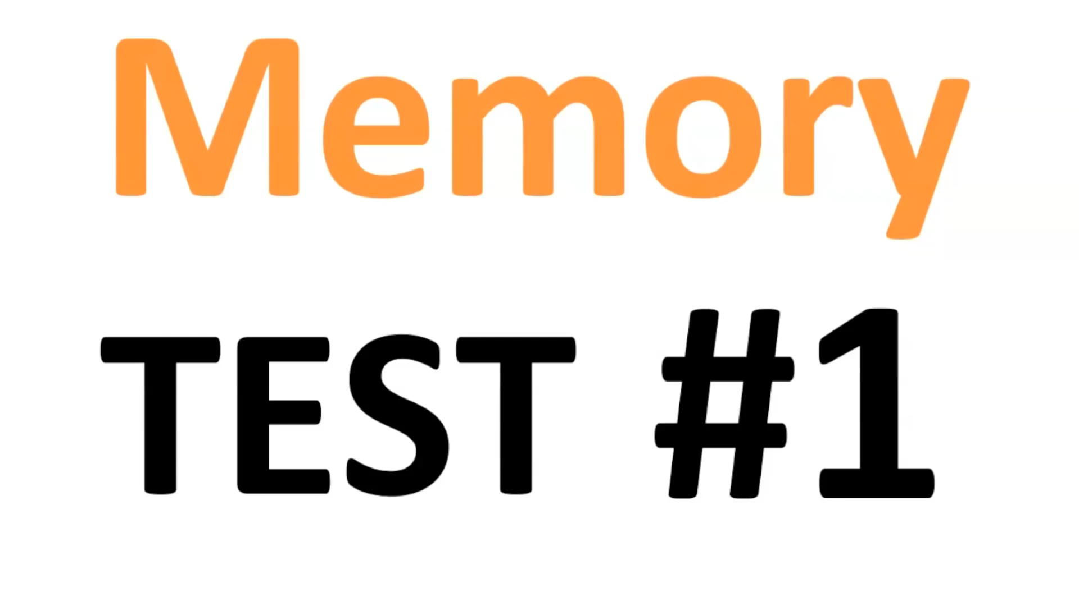
Activity - Short-term Memory

Slide 49
Chunking
Forming information into chunks significantly increases the capacity of short term memory
Try to remember the following:
OUT HWE STU NIV ERS ITYI NCHI NAS

Slide 50
Meaningful Chunking
By moving the last letter to the first position you get……?????
SOUT HWE STU NIV ERS ITYI NCHI NA
Or better still
SOUT HWE STU NIV ERS ITYI NCHI NA
This is because we can recognise patterns in the text

Slide 51

Chunking in Interfaces

Slide 52
Chunking in Interfaces
1
2
3
4

Slide 53
Activity - Chunking in Interfaces
Chunk the Southwest University home page – www.swu.edu.cn
Then answer these questions:
How many sections/chunks did you create?
How did you determine the area that became a chunk?
What impact does this have on website design?

Slide 54

Activity - Chunking in Interfaces

Slide 55
Activity - Chunking in Interfaces
1
2
3
4
5
6
7

Slide 56
Summary
Interaction is a two-way street.
Mental models provide insight into how users think they interact with systems/devices.
Conceptual models are more beneficial than relying on mental models – a shared understanding.
Colour choices require proper consideration to avoid perception issues.
Chunking reduces cognitive load.

